Slide 1
Chapter 14
Functional Dependencies and Normalization for Relational Databases

Slide 2
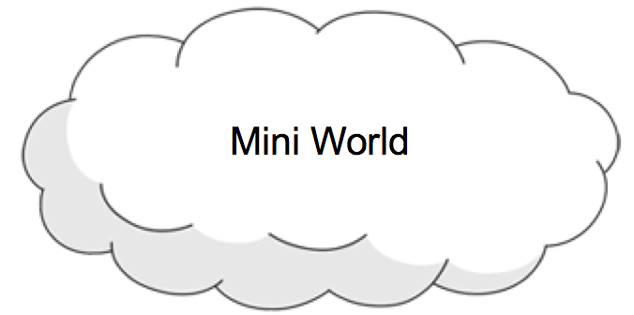




How to create a Database System
Application
DB
Database

Slide 3
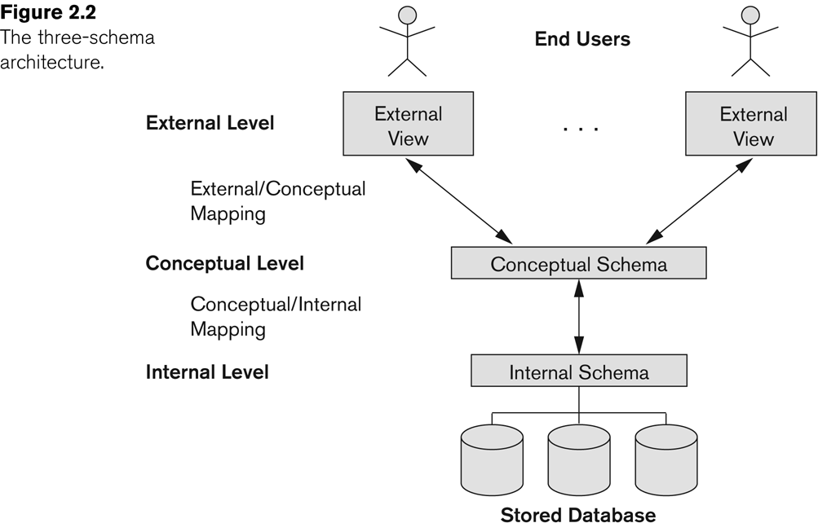
Three-Schema Architecture
derived relations
base relations

Slide 4
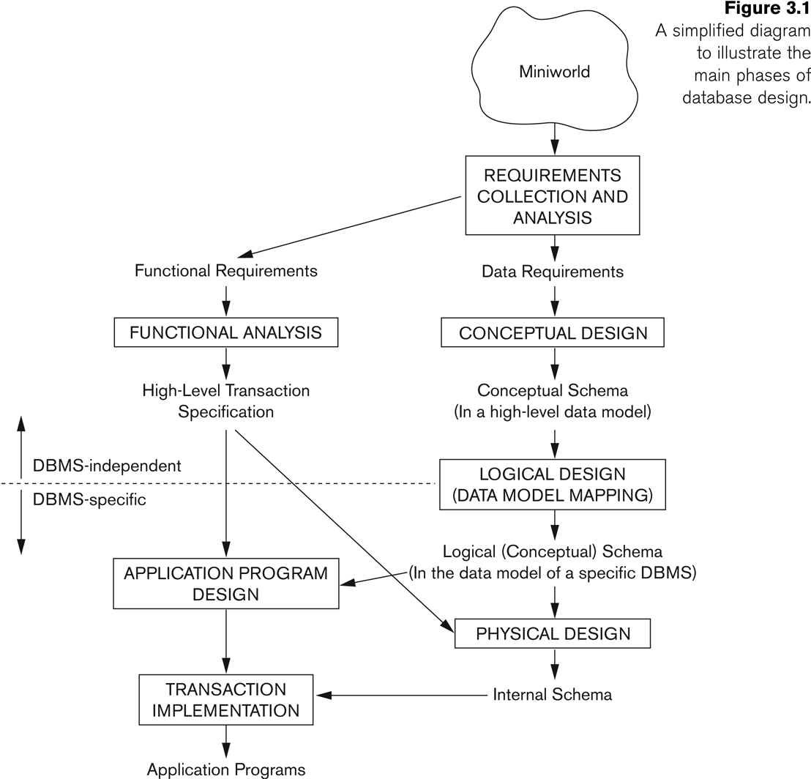

Overview of Database Design Process
Applications design
External schema
Conceptual schema
Internal schema
Database design
Notes:
Requirement collection and analysis
DB requirements and functional requirements
Conceptual DB design using a high-level model
Easier to understand and communicate with others
Logical DB design (data model mapping)
Conceptual schema is transformed from a high-level data model into implementation data model
Physical DB design
Internal data structures and file organizations for DB are specified
Schema Refinement: (Normalization)
Check relational schema for redundancies and anomalies.
Physical Database Design and Tuning:
Consider typical workloads and further refinement of the database design (v.g. build indices).
Application and Security Design:
Consider aspects of the application beyond data. Methodologies like UML often used for addressing the complete software development cycle.

Slide 5
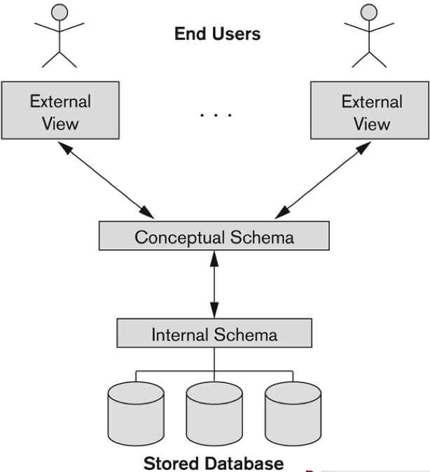
How to create a database
Create views for End Users
Create base relations with SQL DDL
base relations
Specify the storage structures

Slide 6
Chapter Outline
Design Guidelines for Relational Databases
1.1 Semantics of the Relation Attributes
1.2 Redundant Information in Tuples and Update Anomalies
1.3 Null Values in Tuples
1.4 Spurious Tuples
Functional Dependencies (FDs)
2.1 Definition of Functional Dependency
Normal Forms Based on Primary Keys and All Keys

Slide 7
Informal Design Guidelines for RDB
What is relational database design?
The grouping of attributes to form "good" relation schemas
Two levels of relation schemas
"user views" level
"base relation" level
Design is concerned mainly with base relations
What are the criteria for "good" base relations?
user views
base relations

Slide 8
Semantics of the Relational Attributes
GUIDELINE 1: Informally, each tuple in a relation should represent one entity or relationship instance.
Attributes of different entities (EMPLOYEEs, DEPARTMENTs, PROJECTs) should not be mixed in the same relation
Only foreign keys should be used to refer to other entities
Entity and relationship attributes should be kept apart as much as possible.
Bottom Line: Design a schema that can be explained easily relation by relation. The semantics of attributes should be easy to interpret.

Slide 9
Problem Design: Redundant Information in Tuples
Information is stored redundantly
Wastes storage
Causes problems with update anomalies
Insertion anomalies
Deletion anomalies
Modification anomalies

Slide 10
Design 1
Employee
E# | ENAME | AGE | D# | CNAME | LOC
1000 | John | 25 | D1 | CS | MT300
2000 | Kate | 24 | D1 | CS | MT300
3000 | Tony | 24 | D2 | MT | UC231
Repetition of information (data redundancy)

Slide 11
Problem1: Insertion Anormalies
Employee
E# | ENAME | AGE | D# | CNAME | LOC
1000 | John | 25 | D1 | CS | MT300
2000 | Kate | 24 | D1 | CS | MT300
3000 | Tony | 24 | D2 | MT | UC231
Inability to represent certain information
To insert a new employee into the relation, we need to include department information and make sure it is consistent with values for other tuples
Cannot insert a new department that has no employee

Slide 12
Problem 2: Deletion Anomalies
Employee
E# | ENAME | AGE | D# | CNAME | LOC
1000 | John | 25 | D1 | CS | MT300
2000 | Kate | 24 | D1 | CS | MT300
3000 | Tony | 24 | D2 | MT | UC231
Delete the last student also delete the information for the course

Slide 13
Problem 3: Update Anomalies
Employee
E# | ENAME | AGE | D# | CNAME | LOC
1000 | John | 25 | D1 | CS | MT300
2000 | Kate | 24 | D1 | CS | MT300
3000 | Tony | 24 | D2 | MT | UC231
Change the attribute value of course, eg LOC we have to update tuples of all employees who work in the department

Slide 14
GUIDELINE 1
Design a schema that does not suffer from the insertion, deletion and update anomalies.
If there are any anomalies present, then note them so that applications can be made to take them into account.

Slide 15
Problem 4: Null Values in Tuples
Employee
E# | ENAME | AGE | D# | CNAME | LOC
1000 | John | 25 | D1 | CS | MT300
2000 | Kate | 24 | D1 | CS | MT300
3000 | Tony | 24 | D2 | MT | UC231
With several things in one table, it is possible to have many null values in tuples.
Attribute not applicable or invalid
Attribute value unknown (may exist)
Value known to exist, but unavailable
Problems:
waste space
join problem (meaning)
aggregate operations (meaning)

Slide 16
GUIDELINE 2
Relations should be designed such that their tuples will have as few NULL values as possible
Attributes that are NULL frequently could be placed in separate relations (with the primary key)

Slide 17
Problems
Data redundancy
Waste storage space
Causes problems with update anomalies
Insertion anomalies
Deletion anomalies
Modification anomalies
Too many null values
Attribute not applicable or invalid
Attribute value unknown (may exist)
Value known to exist, but unavailable

Slide 18
Conclusion
Employee
E# | ENAME | AGE | D# | DNAME | LOC
1000 | John | 25 | D1 | CS | MT300
2000 | Kate | 24 | D1 | CS | MT300
3000 | Tony | 24 | D2 | MT | UC231
Using a big relation is not a good design
Should divide big relations into smaller relations
How to divide then?

Slide 19
Design 2
Employee
E# | ENAME | AGE | D# | DNAME | LOC
1000 | John | 25 | D1 | CS | MT300
2000 | Kate | 24 | D1 | CS | MT300
3000 | Tony | 24 | D2 | MT | UC231
Employee1
ENAME | AGE | LOC
John | 25 | MT300
Kate | 24 | MT300
Tony | 20 | UC231
Employee2
E# | D# | DNAME | LOC
1000 | D1 | MT300 | MT300
2000 | D1 | MT300 | MT300
3000 | D2 | UC231 | UC231
Can we use Employee1 and Employee2 instead of Employee?
Can we obtain Employee from Employee1 and Employee2?

Slide 20
Design 2
Employee1
ENAME | AGE | LOC
John | 25 | MT300
Kate | 24 | MT300
Tony | 20 | UC231
Employee2
E# | D# | DNAME | LOC
1000 | D1 | CS | MT300
2000 | D1 | CS | MT300
3000 | D2 | MT | UC231
If we natural join the two relations, what do we get?
Employee
E# | ENAME | AGE | D# | DNAME | LOC
1000 | John | 25 | D1 | CS | MT300
1000 | Kate | 24 | D1 | CS | MT300
2000 | John | 25 | D1 | CS | MT300
2000 | Kate | 24 | D1 | CS | MT300
3000 | Tony | 20 | D2 | MT | UC231
We get a relation with spurious tuples. It is a bad design.

Slide 21
Design 3
Employee
E# | ENAME | AGE | D# | DNAME | LOC
1000 | John | 25 | D1 | CS | MT300
2000 | Kate | 24 | D1 | CS | MT300
3000 | Tony | 24 | D2 | MT | UC231
Employee
E# | ENAME | AGE | D#
1000 | John | 25 | D1
2000 | Kate | 24 | D1
3000 | Tony | 20 | D2
Department
D# | DNAME | LOC
D1 | CS | MT300
D2 | MT | UC231
With this design, we can natural join the two relation to obtain the original relation.
It satisfies the "lossless join" property
It is a good design

Slide 22
GUIDELINE 3
The relations should be designed to satisfy the lossless join condition so that no spurious tuples should be generated by doing a natural join of any relations.

Slide 23
DB Design Problem
There are always many different schemas for a given set of data.
E.g., combine or divide tables.
How to pick a schema?
Which is better?
What does “better” mean?
Fortunately, there are some principles to guide us.

Slide 24
Informal Design Guidelines
We must follow some rules to divide relations into smaller relations.
- NF2 (Non First Normal Form)
- 1NF (First Normal Form)
- 2NF (Second Normal Form)
- 3NF (Third Normal Form)
- BCNF (Boyce-Codd Normal Form)
- 4NF (Fourth Normal Form)
- 5NF (Fifth Normal Form)

Slide 25
2. Functional Dependencies
Student
S# | SNAME | AGE
1000 | John | 25
2000 | Kate | 24
3000 | Tony | 20
Employee
E# | ENAME | DEPT | MGR
E1 | John | CS
E2 | Kate | CS | E1
E3 | Tony | CS | E1
Given a relation R, and X and Y are subsets of the attributes of R.
Informal Definition X → Y We say that
“X functionally determines Y.” or “Y functionally depends on X.”
if and only if for each X value in R, there exists exactly one Y value in R.
For each S# value in Student, there exists exactly one SNAME value (also exactly one AGE value): S# → SNAME
For each SNAME value in Team, there exists exactly one AGE value: SNAME → AGE

Slide 26
2. Functional Dependencies
Student
S# | SNAME | AGE
1000 | John | 25
2000 | Kate | 24
3000 | Tony | 20
Employee
S# | SNAME | DEPT | MGR
E1 | John | CS
E2 | Kate | CS | E1
E3 | Tony | CS | E1
t₁,t₂
t₁
t₂
For each S# value in Student, there exists exactly one SNAME value (also exactly one AGE value): S# → AGE
For each SNAME value in Team, there exists exactly one AGE value: SNAME → AGE
Formal Definition X → Y
For any two tuples t₁ and t₂ in any relation instance r(R): If t₁[X]=t₂[X], then t₁[Y]=t₂[Y]
If two tuples have the same values for all the attributes in set X, then they must have the same values for all the attributes in set Y.

Slide 27
2. Functional Dependencies
An FD constrains what can be in a relation.
FDs are derived from the real-world constraints on the attributes not derived from relations.
An FD defines many to one relationship.
X → Y: for any two tuples t1 and t2 in any relation instance r(R): If t1[X]=t2[X], then t1[Y]=t2[Y]
Student |  |  |  | Grade |  |  |  | Course
S# | SNAME | AGE |  | S# | C# | MARK |  | C# | CNAME | LOC
1000 | John | 25 |  | 1000 | CS300 | 90 |  | CS300 | OS | ME300
2000 | Kate | 24 |  | 1000 | CS305 | 85 |  | CS305 | DB | UC231
3000 | Tony | 20 |  | 2000 | CS300 | 85 |  | MT230 | AL | TB300
S# → SNAME
S# → AGE
S# → S#?
S#,C# → C#
S#,C# → MARK
S#,C# → S#?
C# → CNAME
C# → LOC
C# → C#

Slide 28
Why “functional dependency”?
Dependency
because the value of Y depends on the value of X.
Functional
In mathematics, function f takes a value for X and gives a unique value for Y, that is f(X).
f(a) → 1, f(b) → 1, not both f(a) → 1, f(a) → 2
Relational
In mathematics, a relation takes a value for X and can give more than one value, which can be represented as a table.
r: {<a, 1>,<a,2>}

Slide 29
Defining FDs from instances
In order to define the FDs, we need to understand the meaning of the attributes involved and the relationship between them.
From a given relation, all we can conclude is that an FD may exist between certain attributes.
What we can definitely conclude is – that certain FDs do not exist because there are tuples that show a violation of those dependencies.
Student |  |  |  | Grade |  |  |  | Course
S# | SNAME | AGE |  | S# | C# | MARK |  | C# | CNAME | LOC
1000 | John | 25 |  | 1000 | CS300 | 90 |  | CS300 | OS | ME300
2000 | Kate | 24 |  | 1000 | CS305 | 85 |  | CS305 | DB | UC231
3000 | Tony | 20 |  | 2000 | CS300 | 85 |  | MT230 | AL | TB300

Slide 30
Example
Teaches
Teacher | Course | Text
Adam | Programming | Java
Adam | Databases | SQL
Duke | Compilers | Parsing
Evan | Programming | C++
What FDs may exist?
Text → Course
Teacher, Course → Text
What FDs cannot exist?
Teacher → Course
Teacher → Text
Course → Text

Slide 31
Example 2
R
A | B | C | D
a₁ | b₁ | c₁ | d₁
a₁ | b₂ | c₂ | d₂
a₂ | b₂ | c₂ | d₃
a₃ | b₃ | c₄ | d₃
What FDs may exist?
B → C
C → B
AB → C
AB → D
ABC → D
…
What FDs cannot exist?
A → B, A → C, A → D
B → A, B → D, B → D
C → A, C → D,
D → A, D → B, D →C

Slide 32
3.1 Normalization of Relations (1)
Normalization:
The process of decomposing unsatisfactory "bad" relations by breaking up their attributes into smaller relations
Normal form:
Condition using keys and FDs of a relation to certify whether a relation schema is in a particular normal form

Slide 33
Key Constraints
Superkey of a relation R:
is a set of attributes SK of R with the following condition:
No two tuples in any valid relation state r(R) will have the same value for SK
That is, for any distinct tuples t₁ and t₂ in r(R), t₁ [SK] ≠ t₂[SK]
This condition must hold in any valid state r(R)
Car
Serial# | Make | Model | Year | Province | Plate#
1000 | Honda | CRV | 2015 | ON | A-123
2000 | BMW | i3 | 2019 | ON | A-321
3000 | BMW | i6 | 2015 | QC | A-123

Slide 34
Key Constraints
Superkey of a relation R:
is a set of attributes SK of R with the following condition:
No two tuples in any valid relation state r(R) will have the same value for SK
That is, for any distinct tuples t₁ and t₂ in r(R), t₁ [SK] ≠ t₂[SK]
This condition must hold in any valid state r(R)
that uniquely identify the tuples in R
Car
Serial# | Make | Model | Year | Province | Plate#
Serial# | Make | Model | Year | Province
Serial# | Make | Model | Year
Serial# | Make | Model
Serial# | Make
Province | Plate#
Serial#
Province
Plate#

Slide 35
Key Constraints
Key of R:
A "minimal" superkey
That is, a key is a superkey K such that removal of any attribute from K results in a set of attributes that is not a superkey (does not possess the superkey uniqueness property)
A minimal set of attributes that uniquely identify the tuples in R
Car
Serial# | Make | Model | Year | Province | Reg#
Province | Reg#
Superkey?
Serial#

Slide 36
Keys and Attributes Participating in Keys
If a relation schema has more than one key, each is called a candidate key.
primary key is a chosen candidate key
secondary keys are the other candidate key
A prime attribute must be a member of some candidate key
A nonprime attribute is not a prime attribute—that is, it is not a member of any candidate key.

Slide 37
First Normal Form (1NF)
Disallows
composite attributes
multivalued attributes
nested relations; attributes whose values for an individual tuple are non-atomic
Considered to be part of the definition of a relation
A domain has three parts
a name
a data-type/format, and
a set of atomic values (indivisible).
A relation R of degree n on a collection of domain D₁, D₂, ..., D_{n} consists of two parts:
…

Slide 38
Non-First Normal Form (NF2)
First Normal Form disallows
composite attributes
multivalued attributes
nested relations; attributes whose values for an individual tuple are non-atomic
Non-First Normal Form allows
composite attributes
multivalued attributes
nested relations

Slide 39
Normalization into 1NF (Person)
Name |  | Address
 | No. | Street | CITY
Bush | 12 | Queens | Ottawa
Jack | 27 | Kings | Toronto
Mary | 12 | Queens | Ottawa
Name | No. | Street | City
Bush | 12 | Queens | Ottawa
Jack | 27 | Kings | Toronto
Mary | 12 | Queens | Ottawa
Is this a relation based on the definition?
It is not because some attribute values are not atomic
tuples that are decomposible
How to make it a relation?

Slide 40
Normalization into 1NF (CIT)
Course | Instructor | Texts
Math | Green | Algebra
 | Brown | Calculus
Comp | Green | Databases
 |  | Oracle
Laws | Brown | Crimes
Course | Instructor | Text
Math | Green | Algebra
Math | Green | Calculus
Math | Brown | Algebra
Math | Brown | Calculus
Comp | Green | Databases
Comp | Green | Oracle
Laws | Brown | Crimes
Is this a relation in RDM?
Some attribute values are not atomic:
What is it?
How to convert it into a relation?
No
a set {Green, Brown}

Slide 41
Normalization into 1NF (Person)
Name | Children
 | Name | Age
Cook | Dora | 10
 | Mike | 15
John | Mike | 15
 | Judy | 12
Name | Child | Age
Cook | Dora | 10
Cook | Mike | 15
John | Mike | 15
John | Judy | 12
Is this a relation?
Some attribute values are not atomic.
What kind of values: tuples, sets?
How to convert it into a relation?
No

Slide 42
Normalization into 1NF (SP)
S# | Part
 | P# | Pname | City | QTY
S1 | P1 | Nut | London | 300
 | P2 | Bolt | Paris | 200
S2 | P3 | Screw | Rome | 400
 | P5 | Cam | Paris | 100
S3 | P3 | Screw | Rome | 200
 | P4 | Screw | London | 500
S# | P# | Pname | City | QTY
S1 | P1 | Nut | London | 300
S1 | P2 | Bolt | Paris | 200
S2 | P3 | Screw | Rome | 400
S2 | P5 | Cam | Paris | 100
S3 | P3 | Screw | Rome | 200
S3 | P4 | Screw | London | 500
Is this a relation?
Some attribute values are not atomic.
What kind of values: tuples, sets?
Nested relations
How to convert?
No
P1 | Nut | London | 300
P2 | Bolt | Paris | 200

Slide 43
Normalization into 1NF (Director)
Name | Movies
 | Title | Cast
Cook | Ghost | Dora
 |  | Mike
 |  | Cook
John | Beach | Mike
 |  | Judy
 | Dream | Cook
 |  | Dora
Name | Title | Cast
Cook | Ghost | Dora
Cook | Ghost | Mike
Cook | Ghost | Cook
John | Beach | Mike
John | Beach | Judy
John | Dream | Cook
John | Dream | Dora
Some attribute values are not atomic:
What kind of value is it?
Nested Relation with nested relations
How to convert?
Beach | Mike
 | Judy
Dream | Cook
 | Dora

Slide 44
Full Functional Dependencies
A functional dependency X → Y is a full FD if for any proper subset Z of X, not Z→Y
Informally, if and only if the removal of any attribute from X means the FD does not hold any more
Grade
S# | C# | MARK
1000 | CS300 | 90
1000 | CS305 | 85
2000 | CS300 | 85
S#,C# → MARK?
Full functional dependency?
S# → Mark?
C# → Mark?

Slide 45
Second Normal Form
A relation schema is in second normal form (2NF) if every non-prime attribute is fully functionally dependent on the primary key
A relation can be decomposed into 2NF relations via the process of 2NF normalization or “second normalization”
Employee
E# | ENAME | AGE | D# | DNAME | LOC
1000 | John | 25 | D1 | CS | MT300
2000 | Kate | 24 | D1 | CS | MT300
3000 | Tony | 24 | D2 | MT | UC231
What FDs exist?
E# → ENAME, AGE, D#
D# → DNAME, LOC
Is it in 2NF?
DNAME, LOC are not dependent on E#
No

Slide 46
Normalizing into 2NF
Employee
E# | ENAME | AGE | D# | DNAME | LOC
1000 | John | 25 | D1 | CS | MT300
2000 | Kate | 24 | D1 | CS | MT300
3000 | Tony | 24 | D2 | MT | UC231
E# → ENAME, AGE, D#
D# → DNAME, LOC
2NF Normalization
Employee
E# | ENAME | AGE | D#
1000 | John | 25 | D1
2000 | Kate | 24 | D1
3000 | Tony | 24 | D2
Department
D# | DNAME | LOC
D1 | CS | MT300
D2 | MT | UC231
Is every non-prime attribute fully functionally dependent on the primary key?
Are they in 2NF?

Slide 47
Normalizing into 2NF
Student
S# | SNAME | AGE | C# | CNAME | LOC | MARK
1000 | John | 25 | CS300 | OS | ME300 | 90
1000 | John | 25 | CS305 | DB | UC231 | 85
2000 | Kate | 24 | CS300 | OS | ME300 | 85
S# → SNAME, AGE
C# → CNAME, LOC
S#,C# →Mark
Is every non-prime attribute fully functionally dependent on the primary key?
Student
S# | SNAME | AGE
1000 | John | 25
2000 | Kate | 24
3000 | Tony | 20
Grade
S# | C# | MARK
1000 | CS300 | 90
1000 | CS305 | 85
2000 | CS300 | 85
Course
C# | CNAME | LOC
CS300 | OS | ME300
CS305 | DB | UC231
MT230 | AL | TB300
Is every non-prime attribute fully functionally dependent on the primary key?
Are they in 2NF?

Slide 48
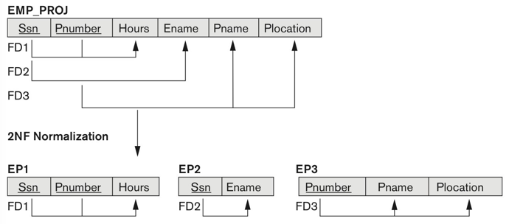
Normalizing into 2NF
Figure 14.11

